Slide 1
SECURE DATA HIDING IN IMAGES USING STEGANOGRAPHY
CAPSTONE PROJECT
Presented By: Abishek P
Student Name : Abishek P
College Name & Department : Adhiyamaan College of Engineering(Autonomous), Department of Information Technology

Slide 2
OUTLINE
Problem Statement
Technology used
Wow factor
End users
Result
Conclusion
Git-hub Link
Future scope

Slide 3
Problem Statement
Risk of Interception: Traditional encryption methods are becoming more vulnerable to interception and unauthorized decryption, especially with the growing need for secure communication.
Suspicion & Vulnerability: Standard security measures tend to attract attention, which makes them more likely targets for breaches and attacks.
Need for Stealthy Data Embedding: It's important to have a discreet yet strong approach for embedding confidential data into digital media without altering its original look.
Steganographic Solution: By hiding sensitive information within images, we can transmit data securely without raising suspicion or risking its integrity.
Focus on Efficiency & Security: The system will emphasize optimizing how we embed data, enhancing its resistance to attacks, and ensuring long-term protection for the information.
Preserving Image Quality: The approach needs to guarantee that any hidden data won't noticeably change the image, allowing for seamless and undetectable communication.

Slide 4
Technology used
Libraries Used in the Program:
OpenCV (cv2) – Used for reading, modifying, and saving images.
OS (Used to execute system commands (e.g., opening the encrypted image).
String (Provides character manipulation utilities (though not used explicitly).
Platform Compatibility:
The program is built for Windows because it uses the command os.system("start encryptedImage.jpg")` to open the image.
However, it can also work on Linux and macOS with a few minor adjustments.
Just make sure you have Python 3.x along with OpenCV (cv2) installed, which you can do by running `pip install opencv-python`.

Slide 5
Wow factors
UNIQUE FACTORS:
Custom Encryption Logic.
Passkey-Protected Decryption.
Real-Time Image Encryption & Decryption .

Slide 6
End users
End Users of the Project :
Cybersecurity Professionals
Corporate & Business Organizations
Privacy-Conscious Individuals

Slide 7
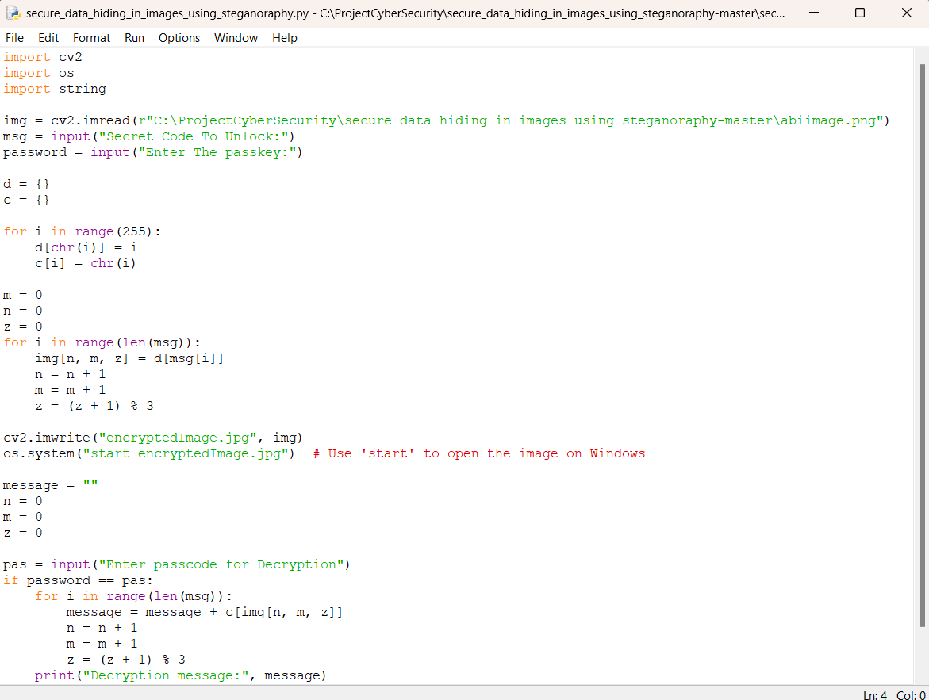
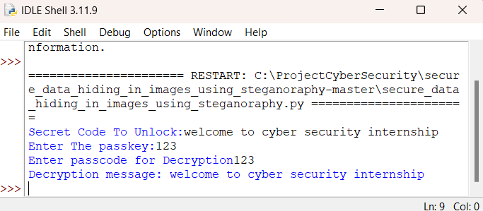

Results

Slide 8
Conclusion
The Steganography Project addresses the tricky issue of covert data transmission by subtly hiding confidential information within digital images without compromising their visual appeal. Unlike traditional encryption methods, which can draw attention and increase the chances of interception, this technology keeps sensitive communications completely off the radar of unauthorized individuals.
With features like passkey-protected decryption and careful pixel adjustments, it enhances security and blocks unauthorized access. This approach utilizes a lightweight but highly effective steganographic technique that reduces image distortion, making it an ideal choice for secure communication in fields like cybersecurity, law enforcement, and corporate data protection.

Slide 9
GitHub Link
The GitHub link:
https://github.com/AbishekP28/secure_data_hiding_in_images_using_steganoraphy

Slide 10
"In the future, I aim to become a leading expert in cybersecurity, protecting organizations from emerging threats and ensuring the safety of digital infrastructures."
Future scope(optional)
In the future, I aim to become a leading expert in cybersecurity, protecting organizations from emerging threats and ensuring the safety of digital infrastructures.

Slide 11
THANK YOU

